Slide 1
DM TA Session 1
Hanwen Serena Xu
hanwen@uchicago.edu
Notes:
Hi everyone, welcome to first week of Data Mining principles TA session.

Slide 2
Contents
Intro
Homework and Final Project
Questions
Sources
Notes:
Today we will not have any conceptual material. I will do a self-introduction, then I am just going to briefly talk about homework, projects and how I will help you through the learning process.

Slide 3

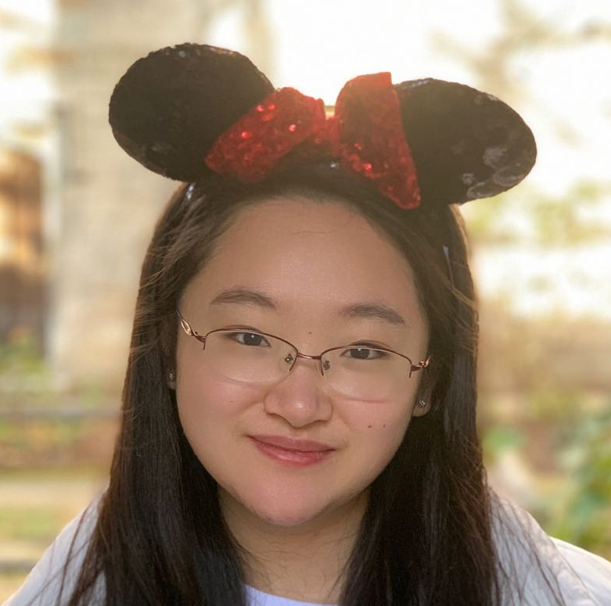








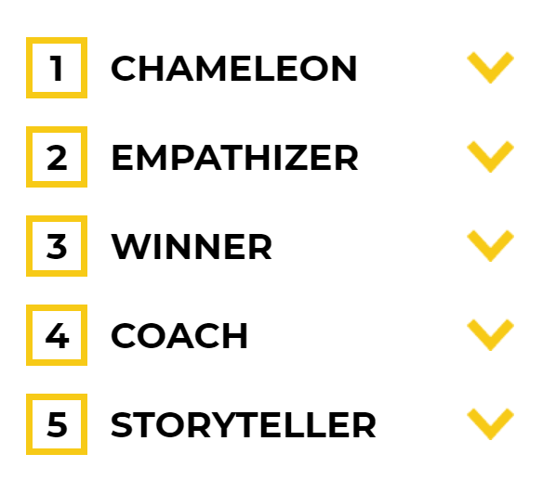


About Me
Interest
A perfect day for me
Serena(Hanwen) Xu
2018-2019
MS in Accounting
2021-
2020-2021
MS in Analytics
2014-2018
International Economics/ Financial Risk Management
Wechat: SerenaXu1919
Email: Hanwen@uchicago.edu
Notes:
I will start with my self-introduction. As you probably can tell, my favorite color is pink. My undergrad is a joint grogram hosted by CUFE in China and Victoria University in Melbourne Australia. I then went to Boston College to get my first master’s degree in accounting, and I enter this program as a full-time student last Spring. I am also a huge fan of the show friends. So if anyone just want to have a zoom call watching friends. I am so down. I took Data Mining class last summer, and I was also the grader for this class last quarter. So, I am very familiar with all the materials and assignments in this class. I consider this class a very important one before you get into more advanced machine learning.

Slide 4
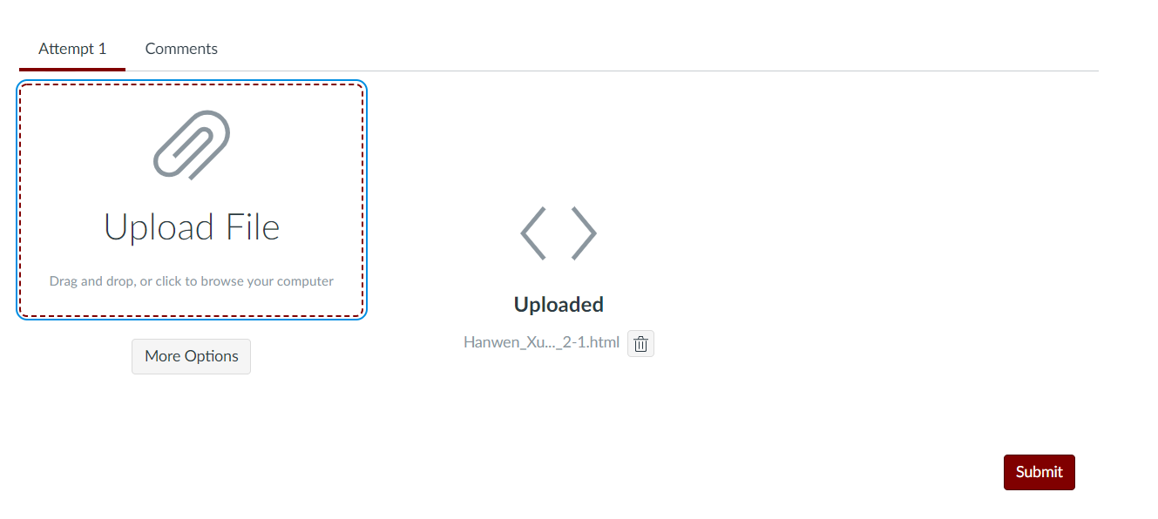
Homework and Final Project
Lateness policy
15% deduction for each day after the deadline
If you have personal emergencies, email Professor and CC me for extension.
Canvas update
About grades
Ideas about the final project
Notes:
I want to say something about homework and final project. Because I saw a lot of lateness in the last quarter, I want to stress here that lateness policy we have in this class is 15% deduction for each day after the ddl. If you have something come up or you don’t feel good and you may miss that ddl, please email professor and cc me beforehand. Professor is very reasonable and considerate, so he will consider all aspects and make fair decisions. What Utku mostly does is to grant a 24-hour extension, and the lateness policy does apply if you miss the extended deadline.
Another thing about homework is the recent Canvas update. Not so recent, it was updated in the beginning of last quarter. However, I notice some students keep forgetting to hit this submit button after uploading the file. I cannot see your submission if you don’t submit. I really do not want anyone to get pints deduction because this little mistake.

Slide 5
Homework and Final Project
About grades
Submitted format
Strongly recommend html accompanied with .ipynb
Please rerun your notebook before submission
Ideas about the final project
Notes:
About grades, assignments are designed to help you learn but not to punish you when you made a mistake. My grading style is that for every single point I deduct, I will clearly state the reason and point you to the right resources. If you get a 5-point deduction in the first assignment, it is OKAY. It really is. The second assignment will give you 15% bonus question, and the question is not hard or time consuming. You can easily make 15% back there. Many students in the last quarter gets final grades greater than 100% even they get a 5 points deduction in the first assignment.
Submitted format. I strongly recommend you submit html version of your notebook so that I can use the speedgrader on Canvas. Pdf would work but sometimes Canvas has glitch on pdf file so that I do not see all pages. You can submit the notebook as well, but it is your responsibility to have the right code and the right result. I have seen people run their notebook not in order, so their code is correct but the result is not. Since html from jupyter is not like R Markdown, it does not rerun the notebook on conversion. My only way to tell whether you made a mistake on running the notebook is to check your result against your code.
I am happy to discuss any ideas you have regarding the final project . If you have multiple datasets on hand and want to discuss the potential on each dataset, we can set up a separate meeting to discuss. I do consider final project as a very importance piece of this class. You can practice every single thing you learn from the class and maybe even more beyond the lectures through working with projects. So I am more than happy to help you along this process.

Slide 6
Questions
Please send in advance, I will be able to dig deeper
Feel free to bring ideas what to cover more
Please provide feedback (what works and what does not)

Slide 7
Recommended sources
Hands-On Machine Learning with R (Boehmke & Greenwell)
Hands-On Machine Learning with Scikit-Learn, Keras, and TensorFlow: Concepts, Tools, and Techniques to Build Intelligent Systems (Geron)
Applied Predictive Modeling (Johnson & Kuhn)
An Introduction to Statistical Learning: With Applications in R (James et al.)
Business Data Science: Combining Machine Learning and Economics to Optimize, Automate, and Accelerate Business Decisions (Taddy)
The Hundred-Page Machine Learning Book (Burkov)
Notes:
Here is some books I think would help. Two of them are machine learning and statistics in R. You may not need it in this class but they are very good reads.

